Slide 1
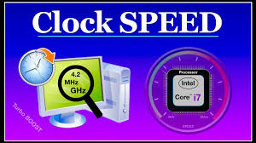
Clock Speed and Instruction per Second
Present by
Md Jakaria Nur

Slide 2

Clock Speed and Instruction per Second
Name: Md. Jakaria Nur
ID: 232-35-252
Section: A
Batch: SWE-41
Dept. Software Engineering

Slide 3
01. What is Clock Speed?
02. What is Instruction per Second?
03. Relationship Between Clock Speed and Instruction per second.
04. Real-World Example of Clock Speed and Instructions per Second.

Slide 4
What is Clock Speed?
Definition:
The clock speed of a processor refers to the frequency at which the CPU executes instructions, measured in hertz (Hz).
Typically expressed in gigahertz (GHz), where 1 GHz = 1 billion cycles per second.
How it Works:
Each cycle allows the processor to perform tasks like fetching, decoding, executing, and storing instructions.
Example:
A CPU with a clock speed of 3.5 GHz can perform 3.5 billion cycles per second.

Slide 5
What is Instruction per Second?
Definition:
The number of instructions a CPU can execute in one second.
Measured in terms like MIPS (Millions of Instructions per Second) or FLOPS
Factors Affecting:
CPU architecture
Clock speed
Instruction set efficiency
Number of cores

Slide 6
Relationship Between Clock Speed and Instruction per Second.
Direct Link:
Higher clock speeds typically mean more instructions can be processed per second.
Limitations:
Clock speed isn’t the only factor. Instructions per cycle (IPC) and parallel processing capabilities play a huge role.
Illustration:
A CPU running at 3 GHz with 4 instructions per cycle will execute 12 billion instructions per second.

Slide 7
Real-world Example of Clock Speed and Instruction per Second.
CPU A: 3.2 GHz with 2 instructions per cycle = 6.4 billion instructions/second.
CPU B: 2.8 GHz with 4 instructions per cycle = 11.2 billion instructions/second.
Clock Speed of Core i3:
The Core i3 processors operate at clock speeds ranging from around 2.0 GHz to 4.5 GHz, depending on the specific model and generation.
This means the processor can complete 2 billion to 4.5 billion cycles per second.

Slide 8
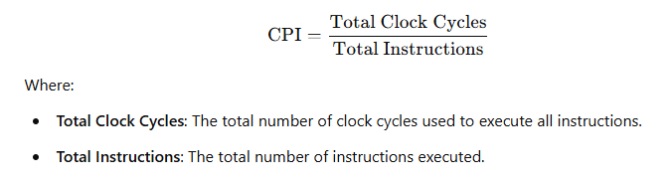
CPI – Cycles per Instruction

Slide 9
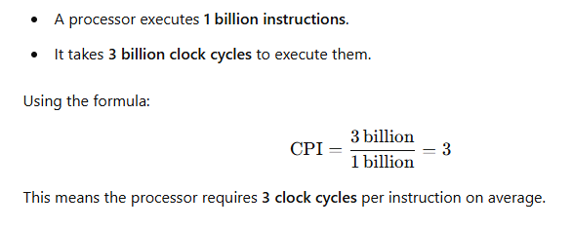
Example of Cycles per Instruction

Slide 10
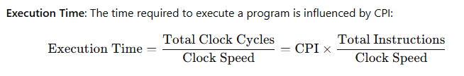
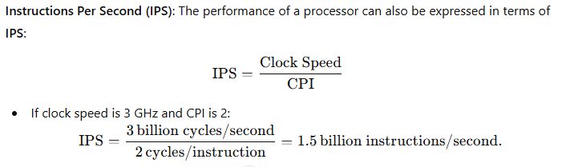
Relationship Between CPI, Clock Speed, and Performance

Slide 11
Conclusion
Clock speed measures how fast a CPU executes cycles, but raw speed is not the only determinant of performance.
Instructions per second provide a clearer picture of real-world CPU capability.
Efficient CPU design balances speed, power, and multitasking.

Slide 12

Thank You!

